Slide 1


UFO Sightings
Team Tenacious:
Abi Chambers
Alejandro Perez
Carlos De La Rosa
Ann Ly

Slide 2

PROJECT PROPOSAL:
UFO Sightings in the United States

Slide 3
DATASET
https://www.kaggle.com/datasets/camnugent/ufo-sightings-around-the-world
We chose a dataset that we could have fun with, but also keep in our portfolios and freely share with a potential employer.

Slide 4
INSPIRATION
The most popular codes on Kaggle used that data in correspondence with meteorite landings and releases of popular movies. Most EDA’s closely resemble the type of analysis that we have done (locations, trends across year, types of UFO shapes).

Slide 5
RESEARCH QUESTIONS
Are there trends in the locations of sightings?
If so, do those trends extend to UFO shapes sighted, or length of the encounter?
Is there any significant relationship between sightings and particular times or dates?
Are there any changes in sighting frequency or locations over time?

Slide 6
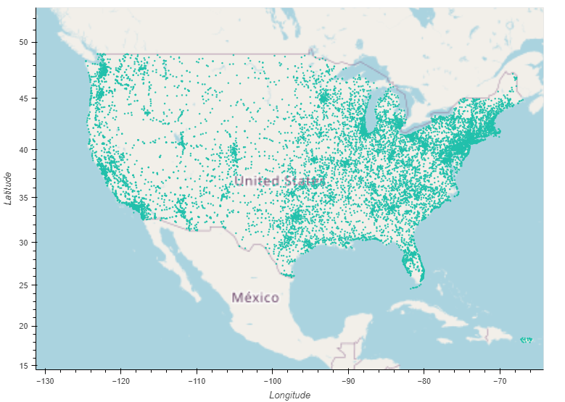
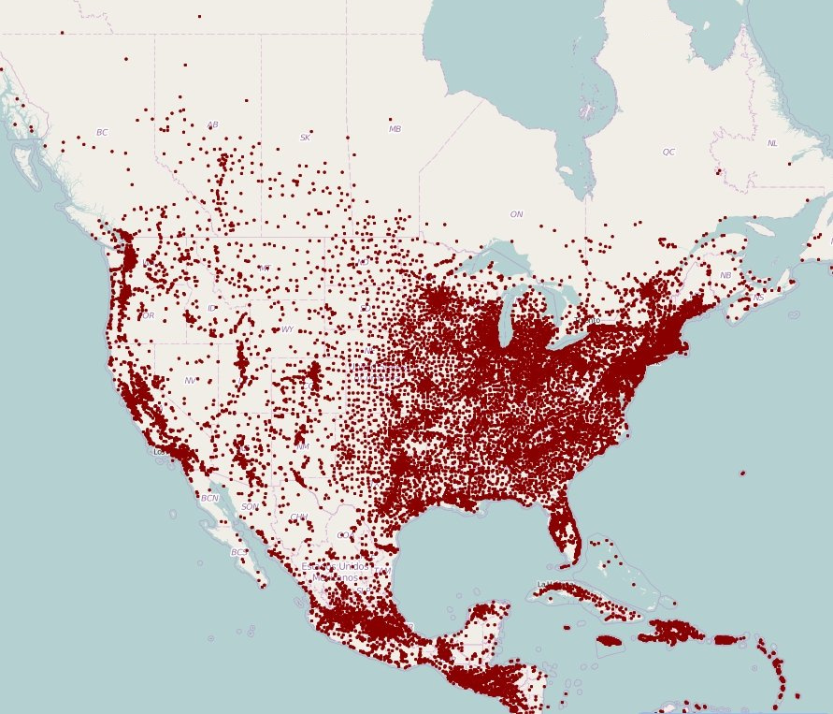
US Encounters: using coordinates of encounters
- cleaned data to look at only US coordinates
- at first glance, it looks like a typical US map showing population density
https://www.visualcapitalist.com/mapping-population-density-dot-town/

Slide 7
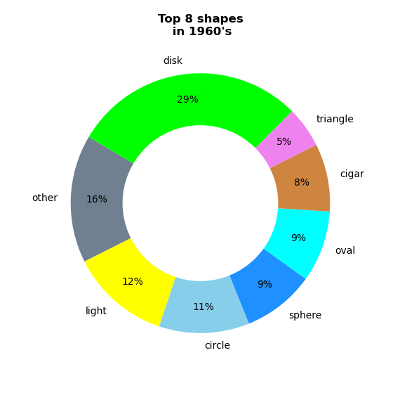
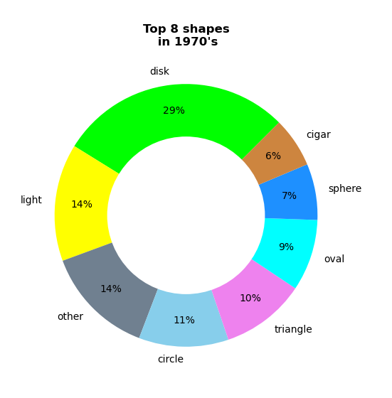
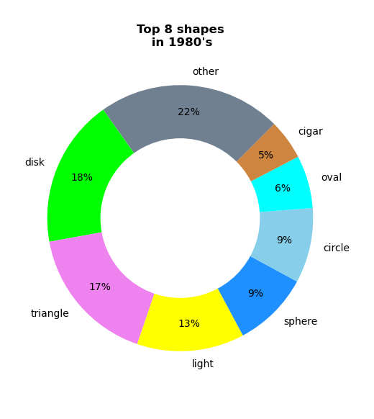
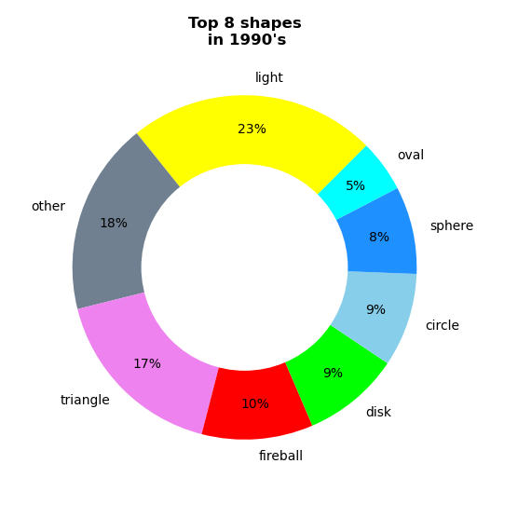
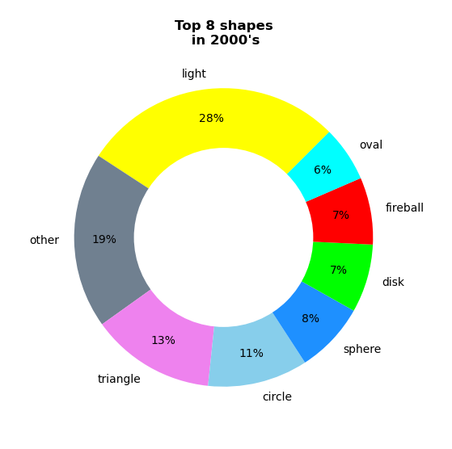
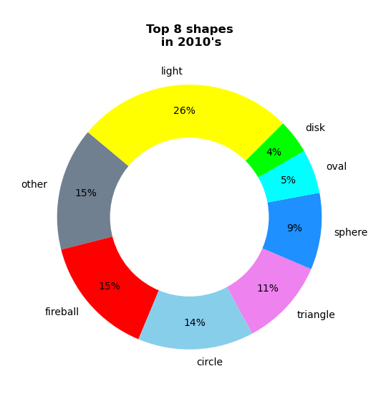
US Encounters: Analysis of the trend of UFO shapes
- used our data to look at the UFO shapes and binning into decades
- saw trends in popularity as 6 shapes were the most popular in 6 decades

Slide 8
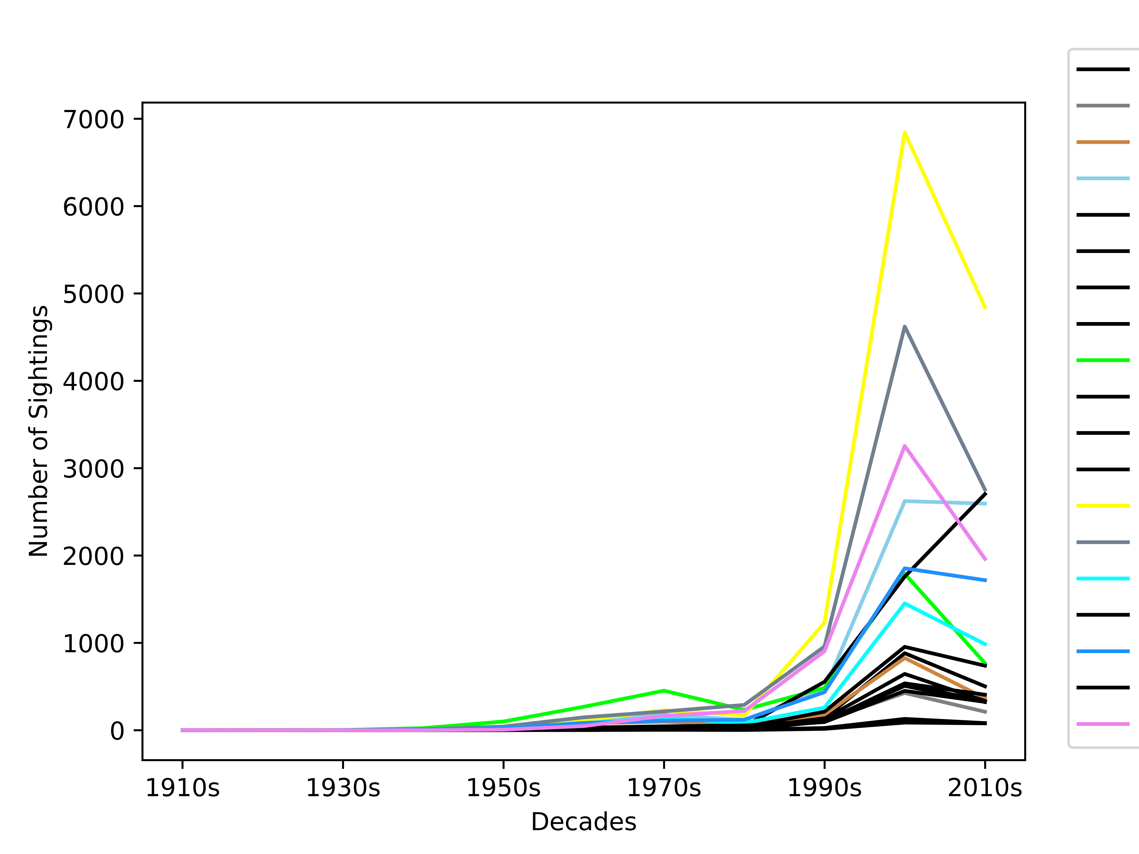
US Encounters: Analysis of the trend of UFO shapes
- used our data to look at the UFO shapes and binning into decades
- saw trends in popularity as 6 shapes were the most popular in 6 decades

Slide 9
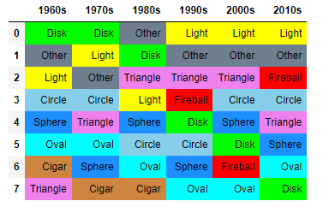
US Encounters: Analysis of the trend of UFO shapes
- used our data to look at the UFO shapes and binning into decades
- saw trends in popularity as 6 shapes were the most popular in 6 decades

Slide 10
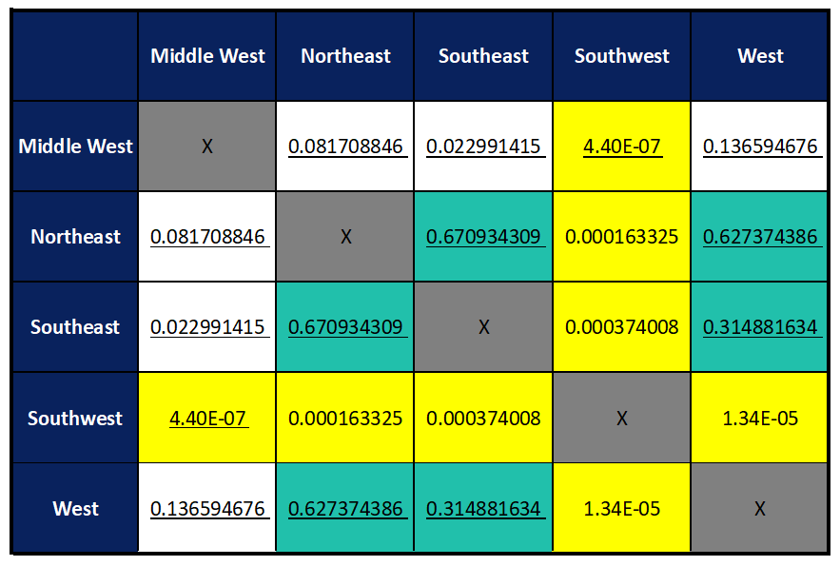
T-testing: using time duration of observation
- we looked at the significant difference between each region with respect to the average length of encounter
- Null Hypothesis: the difference in means for each pair of regions is zero (“the means are the same”)
T-test p-values
- We can reject the null hypothesis of “no difference in mean” and say that the true difference in means is not equal to zero for the pairs highlighted in yellow.
- ie, SW’s average of 154.83 seconds is different than the means in other regions
- Note that the p-values between W, NE, and SE (green) are higher and we can say that the true difference in means IS equal to zero
Means: MW: 173.89 seconds
W: 170.38 seconds
NE: 169.19 seconds
SE: 168.05 seconds
SW: 154.83 seconds

Slide 15
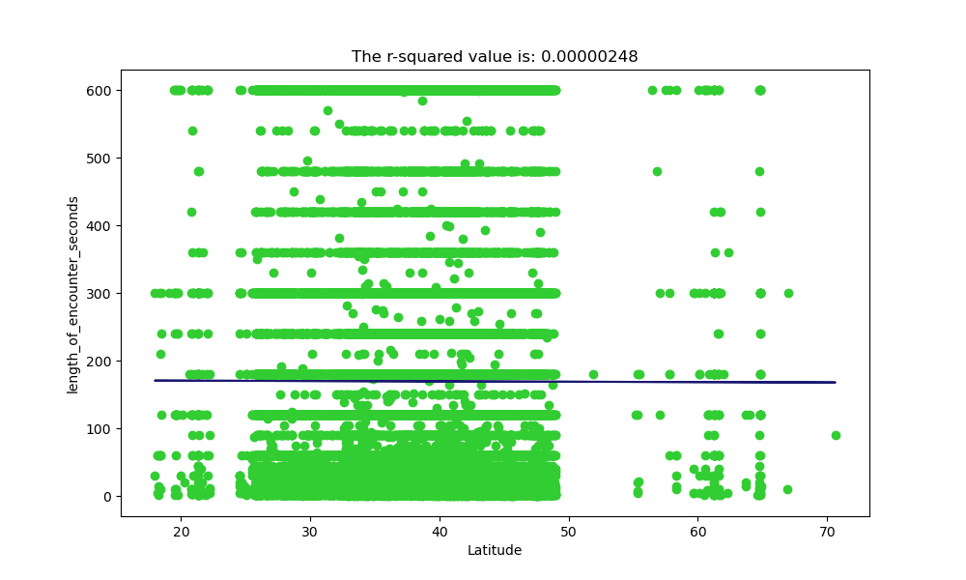
Regression
This is a scatter plot between length of encounters vs. the Latitude. The r2 value turned out to be .00000248 which means there is zero (0) correlation between the latitude and the encounter time.

Slide 16
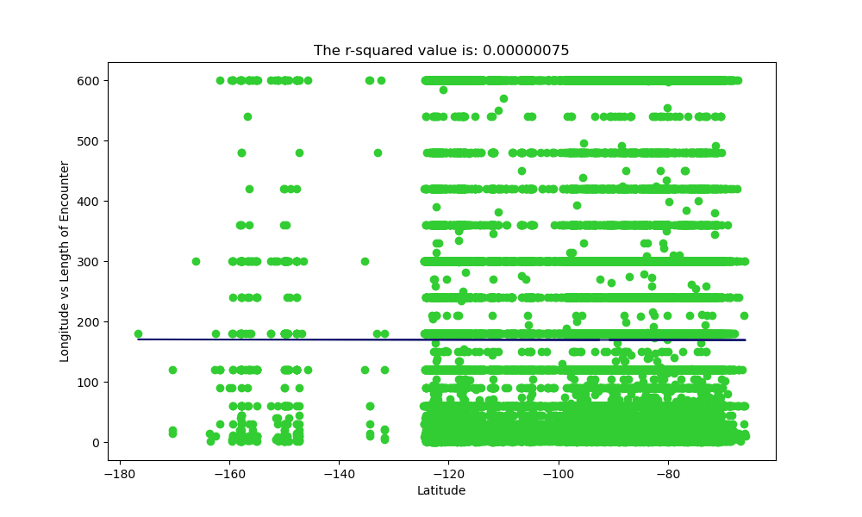
This is a scatterplot between Longitude vs. Length of Encounters

Slide 18
Color Palette

Slide 19
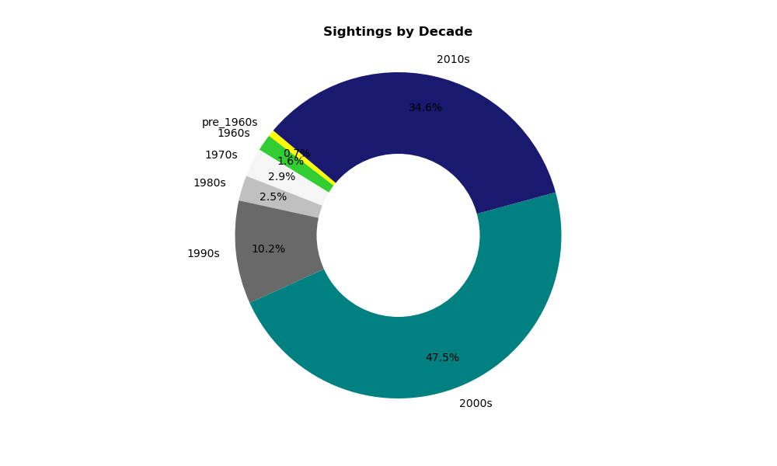

Slide 20
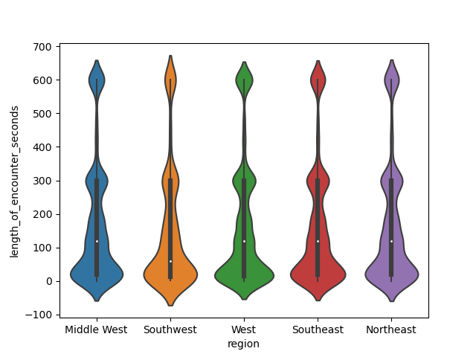

Slide 21
